Slide 1
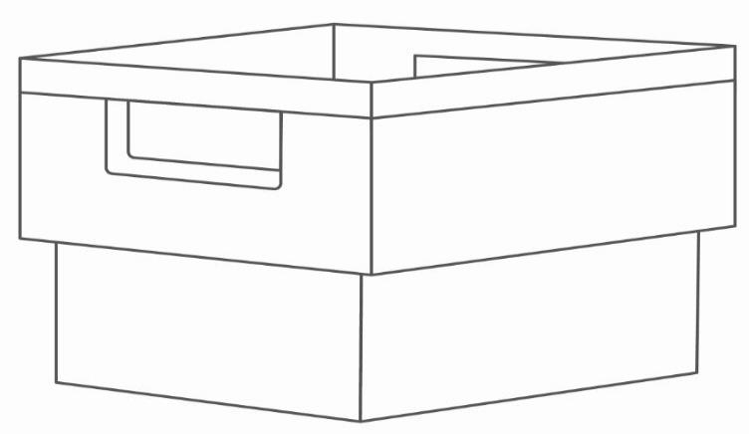
CityMail´s packing instructions for ADR - addressed letter distribution

Slide 2
CityMail´s postal delivery zones from 2023-06-09
Postcodes Destination
100 – 129, 131 – 199 Stockholm – STO
200 – 269 Malmoe – MLM
341 (341 18, 341 21 - 341 51, 341 60, 341 70, 341 80 - 341 85) Malmoe – MLM
400 – 449, 475 Gothenburg – GBG
542 (542 00 – 542 47, 542 72 -542 74, 542 85 – 542 88) Orebro – ÖRE
545 (545 00 -545 35) Orebro – ÖRE
620 – 624 Gotland – GOT
630 – 649 Malardalen – MLD
700 – 711, 713, 715 – 739 Orebro – ÖRE
740 – 741, 743 – 746, 749 – 769 Malardalen – MLD
821, 822 – 823, 828 (821 00 – 821 51), (828 31 – 828 33) Malardalen – MLD

Slide 3
CityMail´s postal delivery zones from 2023-06-09
Postcodes Destination
100 – 129, 131 – 199 Stockholm – STO
630 – 649, 740 – 741, 743 – 746, 749 – 769 Malardalen – MLD
821 00 – 821 51, 822 – 823, 828 31 – 828 33 Malardalen – MLD
200 - 269, 341* Malmo – MLM
400 - 449, 475 Gothenburg – GBG
620 - 624 Gotland – GOT
700 - 711, 713, 715-739, 542, 545** Orebro – ÖRE
* Postcodes 341 18, 341 21 - 341 51, 341 60, 341 70, 341 80 - 341 85
** Postcodes 542 00 – 542 47, 542 73, 542 85 – 542 88, 545 00 – 545 35

Slide 4
Shipment
All items in a shipment must have the same size format (e.g. C4, C5). If a shipment contains items of different sizes, they will be handled and priced as separate shipments or as individual mail items.
The weight of items within a shipment may vary. The maximum per item weight is 2 kg.

Slide 5
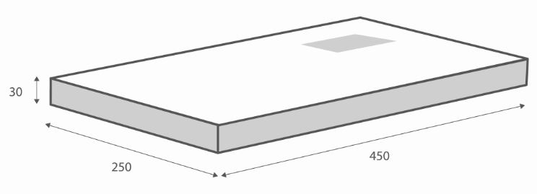
Maximum format
CityMail Sweden AB undertakes to only deliver correctly addressed postal items that is within our specified dimensions.
Standard: 30 x 250 x 450 mm.
Maximum: 80 x 250 x 450 mm.
There is a surcharge for mail items thicker than 30 mm.
By correctly addressed items we mean correct name, street address, postcode and city.

Slide 6
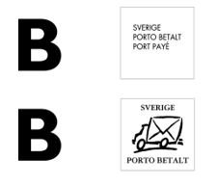
Postage and sender
The postal items must be labelled with one of the following: Sweden Port Payé, Sweden Postage Paid, Customer Magazine, Members' Magazine, Market Journal, Periodicals or any other marking approved by CityMail.
CityMail undertakes to only distribute postal items on which the sender can be clearly read (name and address of sender). A Swedish return address must be specified.

Slide 7
Separation and packing
The postal items must be sorted in ascending or descending order on all five digits in the postcode.
Bundle

Slide 8
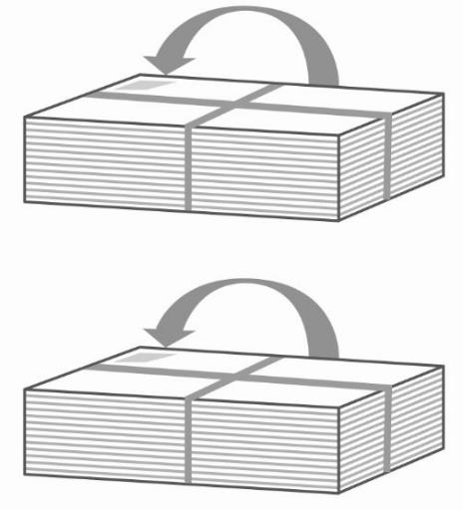
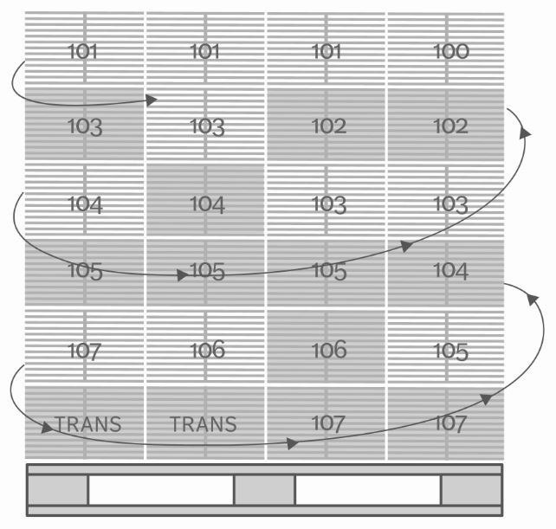
Separation and packing
CM 101
Lokal
Bundles packed straight onto a pallet should normally only contain postal items to recipients within the same three-digit postcode.
Each local bundle must be clearly marked with the three-digit postcode.
Trans bundles are marked with Trans or T and be first or last in the sorting.
The bundles are sorted in ascending or descending order on the pallet.
A bundle is held together by a bundle tie or plastic sheeting.
Recommended maximum weight of a bundle is 7kg.
The bundles are packed in spiral form on the pallet with the address facing upwards.
The pallet must be clearly marked with which postcode it contains. Pallet tags can be found at: https://www.citymail.se/dokument-villkor/
CM 10 - 12
Trans

Slide 9
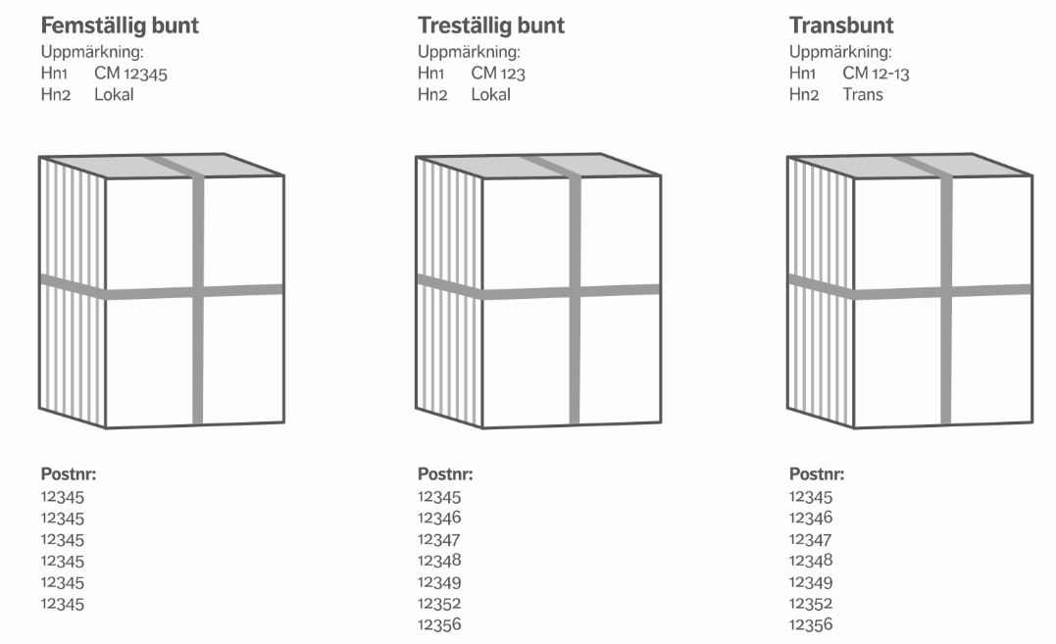
Marking
For volumes exceeding 3 000 items to the same destination*, each bundle as far as possible could contain only one unique three- or five digit postcode. Labeling as five digit bundle respective three digit letter stack below.
Any trans bundles should be packed first or last on the podium or on a separate pallet. Marking according trans bundle below.
Five digit bundle Three digit bundle Trans bundle
*The destinations are found on pages 2 and 3.
Marking:
Marking:
Marking:
Postcode:
Postcode:
Postcode:

Slide 10
Separating destinations
Shipments that exceed 3 pallets as a total to all destinations is supposed to be packed on separate pallets and labeled with the destination. 1 mixed pallet per shipment is approved.
Pallets with bundles must not exceed 120 cm in height including the pallet.
Picture examples on next page.
All goods must be secured before transport!

Slide 11
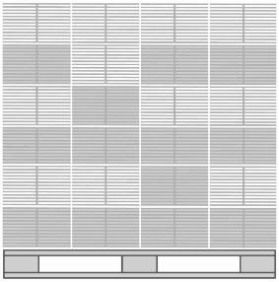
Picture example
STO
MLD
GOT
Postcodes
100 – 129, 131 – 199
Postcodes
630 – 649, 740 – 741, 743- 746, 749 – 769, 821, 822 – 823, 828*
*821 00 - 821 50,828 31-828 33
Postcodes
620 –624
ORE
MLM
GBG
Postcodes
700 – 711, 713, 715 – 739, 542*
*542 00 – 47, 542 73, 542 85 – 88,545 00 - 35
Postcodes
200 – 269, 341* *341 18, 341 21 – 51, 341 60, 341 70, 341 80 – 341 85
Postcodes
400 – 449, 475
All goods must be secured before transport!

Slide 12
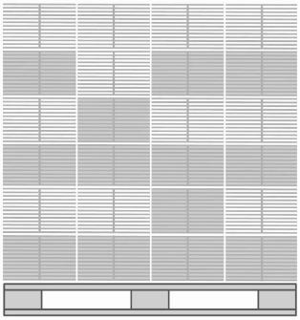
Separating destinations
For smaller dispatches (volume < 4 pallets), several destinations can be placed on the same pallet on condition that all the bundles are clearly labelled and in postcode order.
Each bundle/crate must only contain postal items for the same place of destination.
Every destination must be separated with a sheet of paper.
NOTE! The bundles must be arranged in accordance with the destination order for each delivery destination as illustrated below.
STO
GBG
MLM
GOT
MLM
GBG
ÖRE
MLD
STO
GOT
MLD
STO
ÖRE
MLM
GBG
GOT
ÖRE
MLD
STO
GBG
MLM
All goods must be secured before transport!

Slide 13
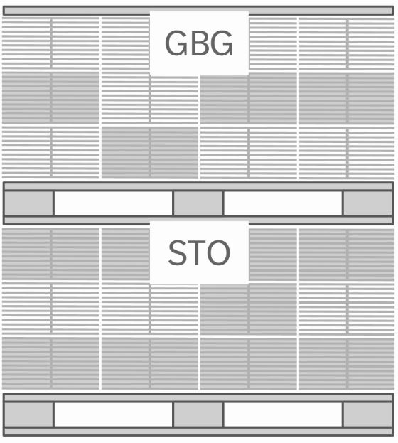
Separating destinations
For smaller volumes to different destinations, pallets can be stacked.
This is done in accordance with the destination order for each delivery destination (see previous slide).
Picture example
MLD
STO
All goods must be secured before transport!

Slide 14
Dispatch booking
Dispatch booking is done at CityMails Partnerwebb: https://partner.citymail.se/
Dispatches with:
< 10 000 postal items must be booked by 12 pm on the day of delivery
≥ 10 000 – 200 000 postal items must be booked by 5 pm the weekday before delivery
> 200 000 postal items must be booked at least 3 weekdays before delivery
Do you need login details to CityMails Partnerwebb?
Please e-mail:
produktionsspecialist.sthlm@citymail.se

Slide 15
Delivery notes
Delivery notes are sent at CityMails Partnerwebb: https://partner.citymail.se/
Delivery notes are sent electronically via the Partnerweb as soon as the goods are ready to leave the customer/post producer and should also be attached to the goods.
Do you need login details to CityMails Partnerwebb?
Please e-mail:
produktionsspecialist.sthlm@citymail.se

Slide 16
Delivery to CityMail
The goods must reach CityMail by 4 pm at the latest 1 weekday before the 1st day of delivery.
Malmoe
CityMail, Malmö
Tegelvägen 4
232 54 Åkarp
leverans.mlm@citymail.se Tel: +46 40-680 85 64
Fax: +46 40-680 85 51
Stockholm
CityMail, Stockholm
Kumla gårdsväg 21
145 63 Norsborg
leverans.sto@citymail.se Tel: +46 8-599 099 60
Fax: +46 8-599 099 69
Gothenburg
CityMail, Göteborg
Ågatan 38
431 37 Mölndal
leverans.gbg@citymail.se Tel: +46 70-752 41 19
Fax: +46 31-706 38 02

Slide 17
Contacts at CityMail
For questions regarding packing and booking, please contact:
Stockholm/Gothenburg/Malmoe
Phone: +46 70-160 23 19 Phone: +46 73-054 35 81 produktionsspecialist.sthlm@citymail.se

