Slide 1
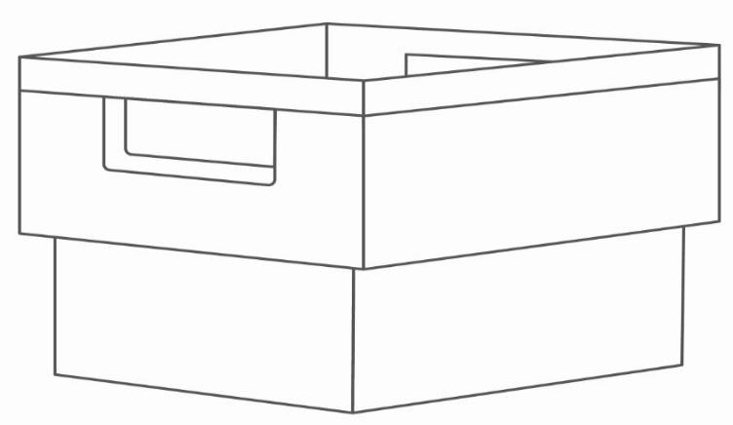
CityMail´s packing instructions for unsorted consignment

Slide 2
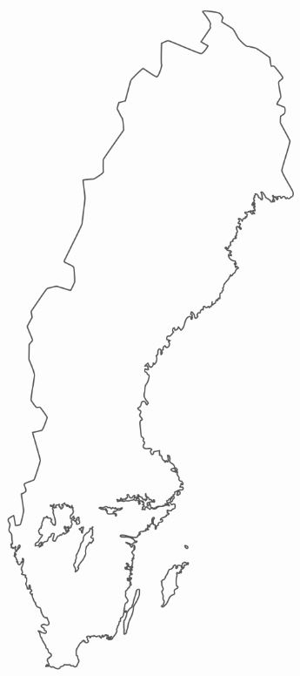
All of Sweden
An Unsorted consignment may contain items to the whole of Sweden, without any requirement for separation or sorting.
Number of items can not be less than 500 copies and weight deviations for unsorted consignment can be no more than 30 grams.
All the items must have similar appearance.
Items are normally distributed within four days.

Slide 3
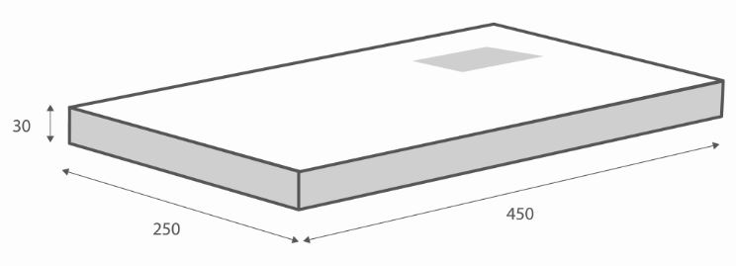
Maximum format
CityMail Sweden AB undertakes to only deliver correctly addressed postal items* that is within our specified dimensions.
Standard: 30 x 250 x 450 mm.
Max weight: 2 kg.
Items thicker than 30 mm may be distributed as agreed. Contact your sales representative for more information.
*By correctly addressed items we mean correct name, street address, postcode and city.

Slide 4
Postage and sender
The postal items must be labelled with the following:
Sweden Port Payé, Sweden Postage Paid or any other marking approved by CityMail.
Sender can be clearly read (name and address of sender).
A Swedish return address must be specified.
Postoperator CityMail.
Postop: CityMail, Kumla Gårdsväg 21
145 63 Norsborg

Slide 5
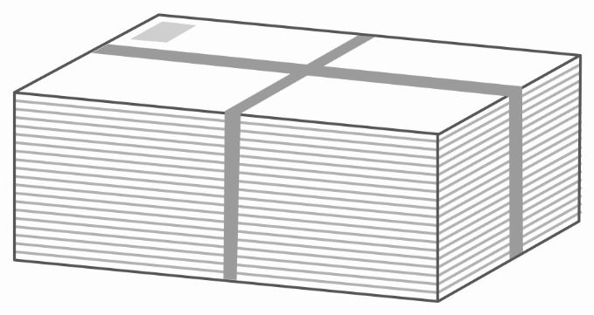
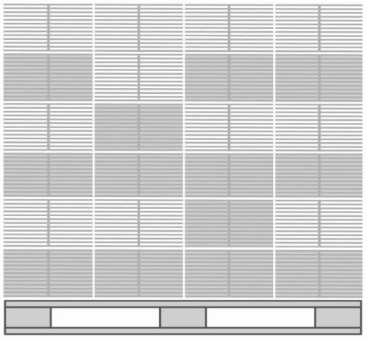
Packing
Bundles are packed directly on pallets to be held together by cable ties or plastic.
Recommended maximum weight of a bundle is 7kg.
The pallet with bundles may have a maximum height of 120 cm incl. pallet.
The pallet must be labeled with the customer, freight senders and "Unsorted consignment".
The pallet can not contain both sorted and unsorted consignments.
Maximum height
1.2 m
All goods must be secured before transport!
Allt gods måste säkras innan transport!

Slide 6
Dispatch booking
Dispatch booking is done at CityMails Partnerwebb: https://partner.citymail.se/
Dispatches with:
< 5 000 postal items must be booked by 12 pm on the day of delivery
≥ 5 000 postal items must be booked by 5 pm the weekday before delivery
Do you need login details to CityMails Partnerwebb?
Please e-mail:
produktionsspecialist.sthlm@citymail.se

Slide 7
Delivery notes
Delivery notes are sent at CityMails Partnerwebb: https://partner.citymail.se/
Delivery notes are sent electronically via the Partnerweb as soon as the goods are ready to leave the customer/post producer and should also be attached to the goods.
Do you need login details to CityMails Partnerwebb?
Please e-mail:
produktionsspecialist.sthlm@citymail.se

Slide 8
Delivery to CityMail
The goods must reach CityMail by 4 pm at the latest 1 weekday before the 1st day of delivery.
Stockholm
CityMail, Stockholm
Kumla gårdsväg 21
145 63 Norsborg
leverans.sto@citymail.se Tel: +46 8-599 099 60
Fax: +46 8-599 099 69

Slide 9
Contacts at CityMail
For questions regarding packing and booking, please contact:
Stockholm/Malmoe
Phone: +46 70-160 23 19 Phone: +46 73-054 35 81 produktionsspecialist.sthlm@citymail.se

