Slide 1
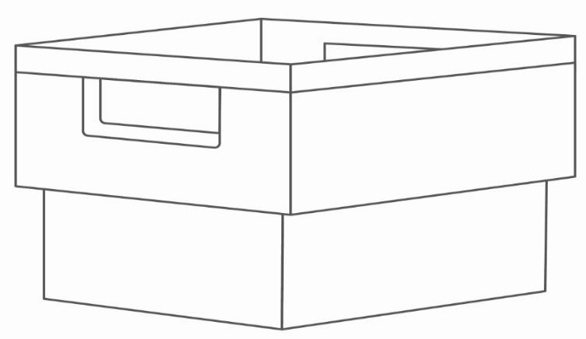
CityMail´s packing instruction for print file optimising program – POP
Applies from 2023-06-09

Slide 2
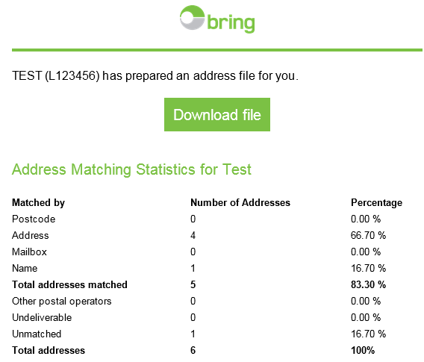
Print file optimising
There are more then one way to POP a file.
Automatically by the Sorteringsprogrammet
Automatically by 21 Grams sorting programs
Integration in companys own Business system/Production system
Upload by function in Customer web/Partner web When the file is complete the program sends an email to selected recipient. The email shows address matching statitics. NOTE! Aplies only to POP in Customer web/Partner web.

Slide 3
Produktionsfil
There will be new columns in the production file.
Serial number: Numbered column to maintain the production order
PrintKey/SortKey: Shall be printed on the postal item
Postal operator: Receiving postal distributor
Buntning/BundleKey: Bundeling support

Slide 4
SortKey
The SortKey is devided in two parts.
One part is for bundeling and packing, the other part is used by CityMail in our production line (highlighted below).
The numbers in the end of the SortKey is changed continuously.
Example sorting by hybrid: Example full sorting by number (are not used today):
STH_114 34 1077 – Local bundle STH_A14 128 0777 – Local bundle
STH_114 34 1077 – Trans bundle STH_A14 128 0777 – Trans bundle
STH_114 34 1077 – Trans bundle STH_A14 128 0777 – Trans bundle
Explanation: Explanation:
STH = Destniation STH = Destination
114 34 = Five digits postal code A, B, C or D= Day
34 = Area index 14 = Group
1077 = Recipient index 128 = Area index
0777 = Recipient index

Slide 5
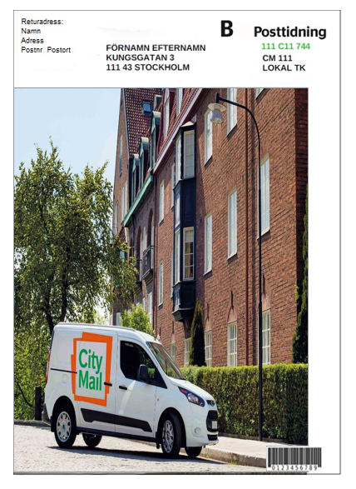
Sorting and bundeling of POP
New HN-codes
For all destinations are sorting by postal code and/or sorting by hybrid used.
Example:
Old HNC CM 111 LOKAL
New HNC LOKAL STH//111
Depending on bundle level, the HN-code can contain different amount of signs.
Example: LOKAL STH//111/43
If it is possible, place the SortKey 4 spaces to the right of the address,
on the same row as street address and the HNC on the same row
as the postal code. See picture example at the side.
Alternatively above the address, see picture example on the next page.
Size and font should be the same as the address.
If the address is smaller than 8 dots the SortKey must be at least 8 dots.
STH 111 43 0345
LOKAL STH//111

Slide 6
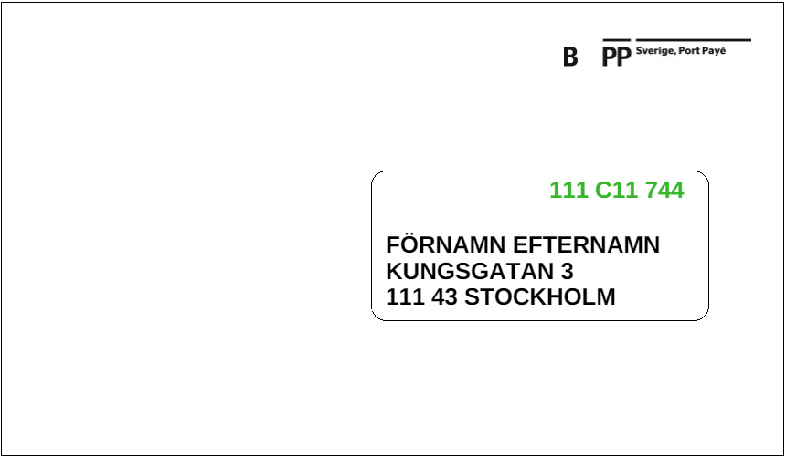
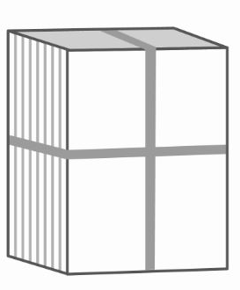
Packning and marking
Bundles Bundles are made with the support from from the bundle logic in the address file, the column BundleKey. Trans bundles are marked with Trans.
Recommended maximum weight of a bundle is 7kg.
NOTE! SortKey and HNC are early drafts and their looks will probably change.
ff
xxxxxxxxxxxxxx
LOKAL STH//11
TRANS STH//11-12

Slide 7
Separating and packing
The items shall be sorted in ascending and descending order within post codes.
Bundles normaly contains one three- or five digit post code.
Each local bundle shall be clearly marked with which post code it contains.
Bundle

Slide 8
Packing order, sorting by hybrid
Local bundles are followed by trans bundles in the respective destinations.
Example:
STH LOKAL - Local bundles both with and without SortKey
STH TRANS - Trans bundles both with and without SortKey
MLM LOKAL - Lokal bundles both with and without SortKey
MLM TRANS - Trans bundles both with and without SortKey
The destinations that has sorting by hybrid gets their item sorted together in postal code order regardless match or no match (means with or without SortKey).
The movers from all destinations will be sorted together, either first or last in destination Stockholm.

Slide 9
Contacts at CityMail
For questions regarding packing and booking, please contact:
Stockholm/Gothenburg/Malmoe
Phone: +46 70-160 23 19 Phone: +46 73- 054 35 81 produktionsspecialist.sthlm@citymail.se

